Slide 1
AASPirations for a Bigger Tomorrow
AASP 2012 Presidential Address
by
Jack C. Watson II
Thank you to Anna-Marie Jaeschke, Alicia Johnson, Rachel Walker,
and Alice Efland for their assistance with the development of the title.

Slide 2
Picking a Topic for this Address
Recent developments in the field
Plan for organizational development
Overview my Presidential initiatives
Overview my research

Slide 3
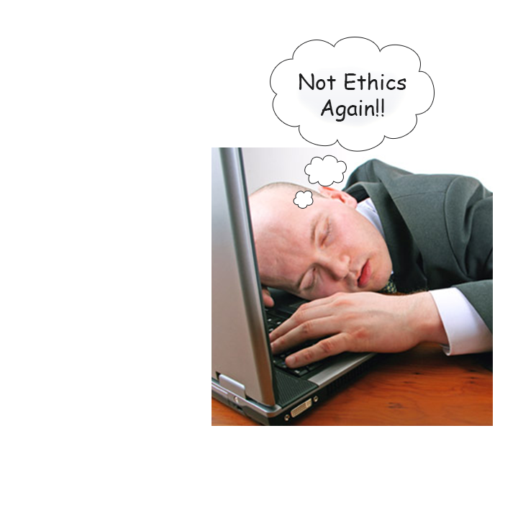
Ethics in Sport Psychology
Ethics Talk =

Slide 4
HELP!

Slide 5
Topics of Address
My orientation to sport psychology
Issues affecting the field
Presidential initiatives
Return on engagement

Slide 6
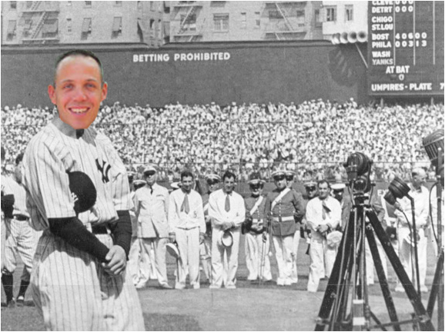
Luckiest Person on Earth

Slide 7
Exposure to Sport Psychology

Slide 8
Orientation to Sport Psychology
Univ. of Virginia
Golf Team
Mechanical Engineering Psychology
Masters degree at West Virginia Univ.
Ph.D. at Florida State Univ.
Post Doc Respecialization at Florida State Univ.
Pre-Doc Internship at West Virginia Univ.

Slide 9
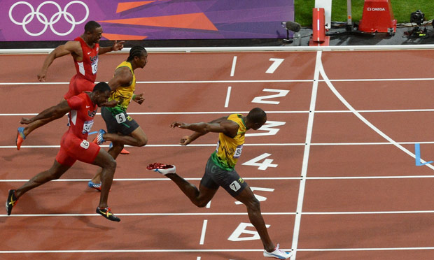
27th Year of AASP
Are we performing at our Peek?
Movement in the right direction
Great management firm
Great E-Board

Slide 10
Major Issues Facing the SEP
Promotion of the field to promote job growth
Improvement of certification system
Connection with other SEP organizations around the world
Promotion of effective graduation education

Slide 11
Focus on Certification
Certification is connected to all aforementioned major issues
Certification is a precursor to most other major issues
Certification can influence the development of the field

Slide 12
Future of Certification
Future of Certification Ad Hoc Committee
Comply with standards set by National Commission for Certifying Agencies (NCCA)
Conduct a Job Task Analysis
Exam based certification

Slide 13
Engagement
Return on Engagement
Return on Investment
Paying it Forward

Slide 14
No, not this mark

Slide 15
Engagement
Return on Engagement
Return on Investment
Paying it Forward

Slide 16
Engagement

Slide 17
What is AASP Doing for Me?
Promoting the field
Promoting professional development
Quality conference
Opportunities to network
Opportunities for mentoring
Present and share your work
Stay current in the profession

Slide 18
What to Expect from AASP
Promote development of new jobs
Improve and expand certification
Look for ways to improve graduate training

Slide 19
Return on Engagement
Measure of:
What portion of members are engaged in important issues of organization?
Do members talk about the organization?
Are members leading organizational initiatives?
Are members staying active in the organization?

Slide 20
Are you willing to work to create change?

Slide 21
Have you read the 2015 Strategic Plan?

Slide 22
Engagement in AASP
Return on engagement leads to:
Return on Investment
Paying it Forward

Slide 23
Ways to be Engaged in AASP
Volunteer for a committee
Run for office
Join a SIG
Stay current on organizational initiatives
VOTE!
Stay engaged in the field
Be the best sport psychology professional or student that you can be

Slide 24
“Stop bitching about it and just do something” Jo Watson (2011)

Slide 25
Generations of AASP
Gen 1: Pioneers in the field. Experienced members. Organizers of the AASP. Considering retirement.
Gen 2: Entered AASP after its formation. Established professional identity.
Gen 3: Students and new professionals. Learning the political system of the field

Slide 26
Generation 1
Serve as mentors, role models, and historians
Take on positions of leadership in the organization
Seek out opportunities to interact with members of Gen 2 and 3.
Be historians
Be involved with and chair committees

Slide 27
Generation 2
Start taking on leadership positions
Ask important questions and listen for the answers
Seek out mentoring and role models
Get involved with a committee or SIG
Stay abreast of the important issues
Make your voice heard
Be positive role models

Slide 28
Generation 3
You have a big voice
Be active learners in the field
Get involved in a committee or SIG
Stay active in understanding important initiatives
Find a mentor and role model

Slide 29
Mission of AASP
“To lead the field of sport and exercise psychology through research, education, and practice and to promote the field to the public”

Slide 30
“Stop bitching about it and just do something” Jo Watson (2011)

Slide 31
Thank You!

